Slide 1
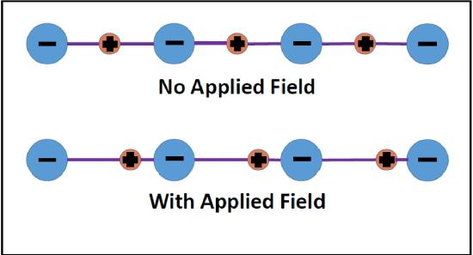
Electrodynamics and Ions in Chemistry
Applied Electric Field ZERO
Applied Electric Field NOT ZERO

Slide 2
Electrodynamics and Ions
in Chemistry
Bob Eisenberg
Temple University Lecture Series
Second Afternoon
Institute for Computational Molecular Science
April, 2015

Slide 3
The Electric Field is Strong
If you were standing at arm’s length from someone and each of you had
One percent more electrons than protons,
the force
would lift the
Entire Earth!
slight paraphrase of third paragraph, p. 1-1 of
Feynman, R. P., R. B. Leighton, and M. Sands. 1963. The Feynman: Lectures on Physics, Mainly Electromagnetism and Matter. New York: Addison-Wesley Publishing Co.,
also at http://www.feynmanlectures.caltech.edu/II_toc.html.

Slide 4
Concentration Fields are Weak
One percent change in concentrations does almost nothing
The Electric Field is Strong
One percent change in charge
lifts the Earth,

Slide 5
Electrostatics and Chemistry
“… all forces
on atomic nuclei in a molecule
can be considered as
purely classical attractions
involving
Coulomb’s law.”
“The electron cloud distribution is prevented from collapsing by obeying Schrödinger’s equation.”
R.P. Feynman (1939)
Forces in Molecules.
Physical Review 56: 340.

Slide 6
How can this be?
Chemistry is about Chemicals
not signals

Slide 7
Law of Mass Action
is how chemists have described chemicals,
not flows
k is constant
[ A] means the activity or approximately the concentration of species A, i.e., the number density of A

Slide 8
‘Current-in’ does not equal ‘Current-out’
in Rate Models
if rate constants are independent and Currents are Uncorrelated

Slide 9
Correlation
between currents is in fact
ALWAYS
0.999 999 999 999 999 999
because
Continuity of Current is Exact
Kirchoff Continuity of Current Law including displacement current
is another form of Maxwell’s Equations Heras, J.A.: Am J Phys 75: 652 (2007); Eur J Phys 30: 845 (2009); Am J Ph79: 409 (2011)

Slide 10
More specifically
In general
The discussion assumes the reactants A, B, …. are at different spatial locations. The discussion assumes reactants are charged, as they almost always are with fixed and/or permanent dipole charges

Slide 11
Engineering
is about
Signal Flow
not chemicals

Slide 12
Maxwell’s Equations
Kirchoff’s Current Law
compute
Signals from Conservation of Charge and Continuity of Current, including displacement current

Slide 13
Law of Mass Action
is about Conservation of Mass and Matter It is not about conservation of charge
[X] means the concentration, really activity of species Z, i.e., concentration is the number density

Slide 14
[X] means the concentration, really activity of species Z, i.e., concentration is the number density

Slide 15
Parameterization is not Possible
under more than one condition
Rate constants chosen at one boundary charge or one potential cannot work for different charges or potentials
Currents in Rate Models are Independent of Charge and Potential
but
in the real world
Currents depend on Charge and Potential

Slide 16

Parameterization is not Possible
under more than one condition
because
Electric Field is Global
SPARKS
Pop!
*speaking loosely

Slide 17
Mathematics of Continuity
in Maxwell equations can Create New Kind of Physics, New Kind of Charge
When we unplug a computer power supply, we often CREATE SPARKS, i.e., a PLASMA, a NEW KIND
of current flow
Pop!

Slide 18
Continuity of Current is Exact
even though Physics of Charge Flow
Varies Profoundly
Maxwell Equations are Special
‘Charge’ is an Abstraction
with VERY different Physics in different systems

Slide 19
Kirchoff Current Law and Maxwell Equations are nearly the same thing
Bhat & Osting (2011). IEEE Trans Antennas and Propagation 59: 3772-3778
Heras (2007) American Journal of Physics 75: 652-657
Heras (2011) American Journal of Physics 79: 409
Itzykson & Zuber Quantum Field Theory (1990) p. 10

Slide 20
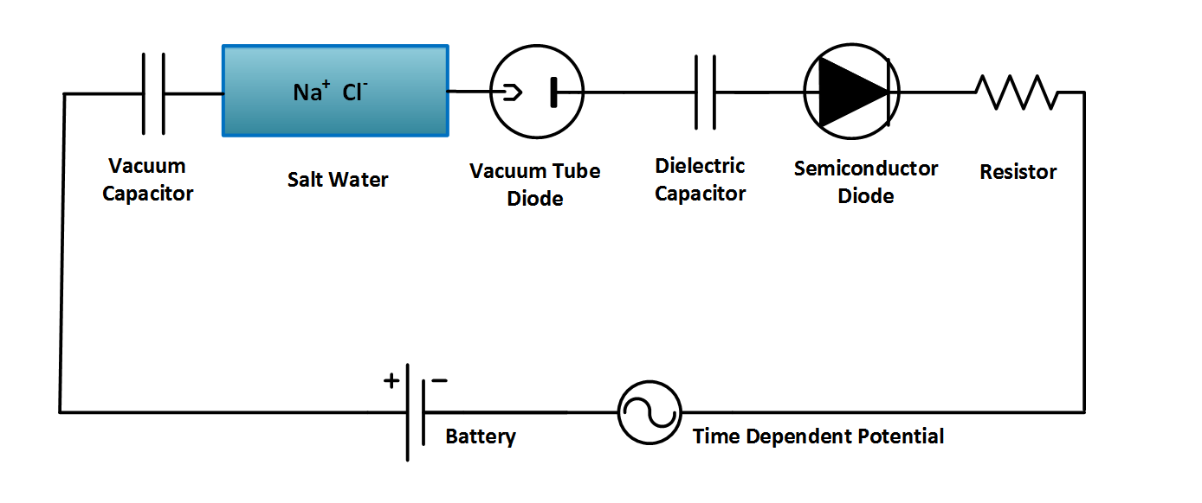
but Continuity of Current is Exact No matter what carries the current!
‘Charge’ is an Abstraction
with different Physics in different systems
Ag AgCl
Ag AgCl
D = permittivity × E

Slide 21
Continuity of Current is Exact no matter what carries the current
Maxwell Equations are Special
even though Physics of Charge Flow
Varies Profoundly
even Creating Plasmas!
‘Charge’ is an Abstraction
with VERY different Physics in different systems

Slide 22
Maxwell Equations
as written by Heaviside, using Gibbs notation
Displacement Current
Everywhere!

Slide 23
Generalized Current
is
Conserved
Maxwell Equation
Displacement Current
Everywhere!
Vector Identity
Conservation law
Generalized Current

Slide 24
All of Biology occurs in Salt Solutions
of definite composition and concentration
and that matters!
Salt Water is the Liquid of Life
Pure H₂O is toxic to cells and molecules!
Salt Water is a Complex Fluid
Main Ions are Hard Spheres, close enough
Sodium Na⁺ Potassium K⁺ Calcium Ca²⁺ Chloride Cl⁻
K⁺
Na⁺
Ca⁺⁺
Cl⁻
3 Å

Slide 25
Central Result of Physical Chemistry
Ions in a solution are a Highly Compressible Plasma
although the Solution is Incompressible
Free energy of an ionic solution is mostly determined by the Number density of the ions. Density varies from 10⁻¹¹ to 10¹M in typical biological system of proteins, nucleic acids, and channels.
Learned from Doug Henderson, J.-P. Hansen, Stuart Rice, among others…Thanks!

Slide 26
Electrolytes are Complex Fluids
Treating a Complex Fluid as if it were a Simple Fluid will produce Elusive Results

Slide 27

Electrolytes are Complex Fluids
After 690 pages and 2604 references, properties of SINGLE Ions are Elusive* because Every Ion Interacts with Everything
*elusive is in the authors’ choice of title!
Hünenberger & Reif (2011) Single-Ion Solvation. Experimental and Theoretical Approaches to Elusive* Thermodynamic Quantities. 2011

Slide 28
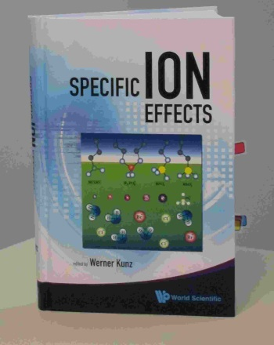
It is not surprising that Inconsistent Treatments of ionic solutions have been so Unsuccessful
despite more than a century of work by fine scientists and mathematicians
Werner Kunz:
“It is still a fact that over the last decades, it was easier to fly to the moon than to describe the free energy of even the simplest salt solutions beyond a concentration of 0.1M or so.”
Kunz, W. "Specific Ion Effects"
World Scientific Singapore, 2009; p 11.

Slide 29
Shielding is a defining property of Complex Fluids
It is VERY hard to Simulate at Equilibrium
and (in my opinion)
IMPOSSIBLE to Simulate in nonequilibrium
Like Batteries or Nerve Fibers
because flows involve Far Field (macroscopic) boundaries

Slide 30
Main Qualitative Result
Shielding Dominates
Electric Properties of Channels, Proteins, as it does Ionic Solutions
Shielding is ignored in traditional treatments
of Ion Channels and of Active Sites of proteins
Rate Constants Depend on Shielding
and so
Rate Constants Depend on Concentration and Charge

Slide 31
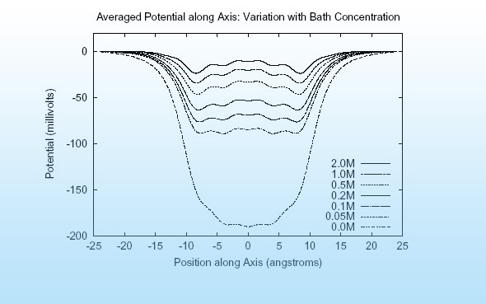
Main Qualitative Result Shielding in Gramicidin
Hollerbach & Eisenberg

Slide 32
Reconciling
Mass Action
and
Maxwell/Kirchoff
will no doubt be a
Long Journey

Slide 33
“ … incomplete truths learned on the way
may become ingrained and taken as the whole truth….… what is true and what is only sometimes true will become confused.”
Richard Feynman
from p.15-61 “The Feynman: Lectures on Physics, Mainly Electromagnetism and Matter. Vol. 2” 1963, New York: Addison-Wesley Publishing Co., also at available on line

Slide 34
History of Derivations of Law of Mass Action
“Sometimes it is necessary to put a veil on the past, For the Sake of the Future”
Henry Clay, the Essential American
p. 375 D.S. & J.T. Heidler

Slide 35
“Journey of a thousand miles starts with a single step”
in the right direction,
I beg to add to this Chinese saying

Slide 36
As a Chicago Surgeon put it
You better head in the right direction,
if you want to get anywhere

Slide 37
That direction needs to include the electric field, calculated and calibrated, global and local if the journey is ever to end, in my view.

Slide 38
Replacement of “Law of Mass Action” is Feasible for Ionic Solutions
using the All Spheres (primitive = implicit solvent model of ionic solutions) and Theory of Complex Fluids

Slide 39

Variational Approach
EnVarA
‘Law’ of Mass Action including Interactions
Conservative
Dissipative
From Bob Eisenberg p. 1-6, in this issue

Slide 40
Energetic Variational Approach allows
accurate computation of Flow and Interactions in Complex Fluids like Liquid Crystals
Classical theories and Molecular Dynamics have difficulties with flow, interactions, and complex fluids
Engineering needs Calibrated Theories and Simulations
Engineering Devices almost always use flow

Slide 41
Energetic Variational Approach EnVarA Chun Liu, Rolf Ryham, and Yunkyong Hyon
Mathematicians and Modelers: two different ‘partial’ variations
written in one framework, using a ‘pullback’ of the action integral
Shorthand for Euler Lagrange process
with respect to
Shorthand for Euler Lagrange process
with respect to
Action Integral, after pullback
Rayleigh Dissipation Function
Composite Variational Principle
Euler Lagrange Equations
Field Theory of Ionic Solutions: Liu, Ryham, Hyon, Eisenberg
Allows boundary conditions and flow Deals Consistently with Interactions of Components

Slide 42
Dissipation Principle Conservative Energy dissipates into Friction
Number Density
time
Permanent Charge of protein
Hard Sphere Terms
Thermal Energy
valence
proton charge
c_{i} number density; thermal energy; D_{i} diffusion coefficient; n negative; p positive; z_{i} valence; ε dielectric constant
Note that
with suitable boundary conditions

Slide 43
Energetic Variational Approach EnVarA
is defined by the Euler Lagrange Process,
as I understand the pure math from Craig Evans
which gives Equations like PNP
BUT
I leave it to you (all)
to argue/discuss with Craig about the purity of the process when two variations are involved

Slide 44
PNP (Poisson Nernst Planck) for Spheres
Non-equilibrium variational field theory EnVarA
Nernst Planck Diffusion Equation
for number density c_{n} of negative n ions; positive ions are analogous
Diffusion Coefficient
Thermal Energy
Coupling Parameters
Ion Radii
Number Densities
Poisson Equation
Dielectric Coefficient
valence
proton charge
Eisenberg, Hyon, and Liu
Permanent Charge of Protein

Slide 45
Semiconductor PNP Equations For Point Charges
Dielectric Coefficient
Poisson’s Equation
Permanent Charge of Protein
Valence
Proton charge
Cross sectional Area
Drift-diffusion & Continuity Equation
Number Densities
Flux
Diffusion Coefficient
Chemical Potential
Not in Semiconductor
valence
proton charge
Thermal Energy

Slide 46
All we have to do is Solve them! with Boundary Conditions defining Charge Carriers ions, holes, quasi-electrons Geometry

Slide 47
Solution* of PNP Equation
*MATHEMATICS
This solution was actually DERIVED by computing many conditional probability measures explicitly by repeated analytical integrations
Eisenberg, Klosek, & Schuss (1995) J. Chem. Phys. 102, 1767-1780 Eisenberg, B. (2000) in Biophysics Textbook On Line "Channels, Receptors, and Transporters" Eisenberg, B. (2011). Chemical Physics Letters 511: 1-6

Slide 48
Please do not be deceived by the eventual simplicity of Results. This took >2 years!
Solution was actually DERIVED with explicit formulae for probability measures from a Doubly Conditioned Stochastic Process involving Analytical Evaluation of Multidimensional Convolution Integrals
Eisenberg, Klosek, & Schuss (1995) J. Chem. Phys. 102, 1767-1780 Eisenberg, B. (2000) in Biophysics Textbook On Line "Channels, Receptors, Transporters" Eisenberg, B. (2011). Chemical Physics Letters 511: 1-6

Slide 49
All we have to do is Solve them! Don’t Despair Semiconductor Technology has Already Done That!

Slide 50
Semiconductor Devices
PNP equations describe many robust input output relations
Amplifier
Limiter
Switch
Multiplier
Logarithmic convertor
Exponential convertor
These are SOLUTIONS of PNP for different boundary conditions
with ONE SET of CONSTITUTIVE PARAMETERS PNP of POINTS is TRANSFERRABLE Analytical should be attempted using techniques of Weishi Liu University of Kansas Tai-Chia Lin National Taiwan University & Chun Liu PSU

Slide 51
The End
Any Questions?

